Slide 1

Player Performance Predictor: Revolutionizing Cricket Analytics
Presented by:
Ahmer Moon Majid (FA22-BCS-085)
Muhammad Hassan (FA22-BCS-168)

Slide 2




The Power of Data in Cricket
Modern Sports Analytics
Impact on Strategy
Enhancing Performance
Data is essential in modern sports analytics. It drives strategic decisions.
It impacts strategy, player development, and fan engagement.
Data-driven decisions enhance overall team performance.

Slide 3
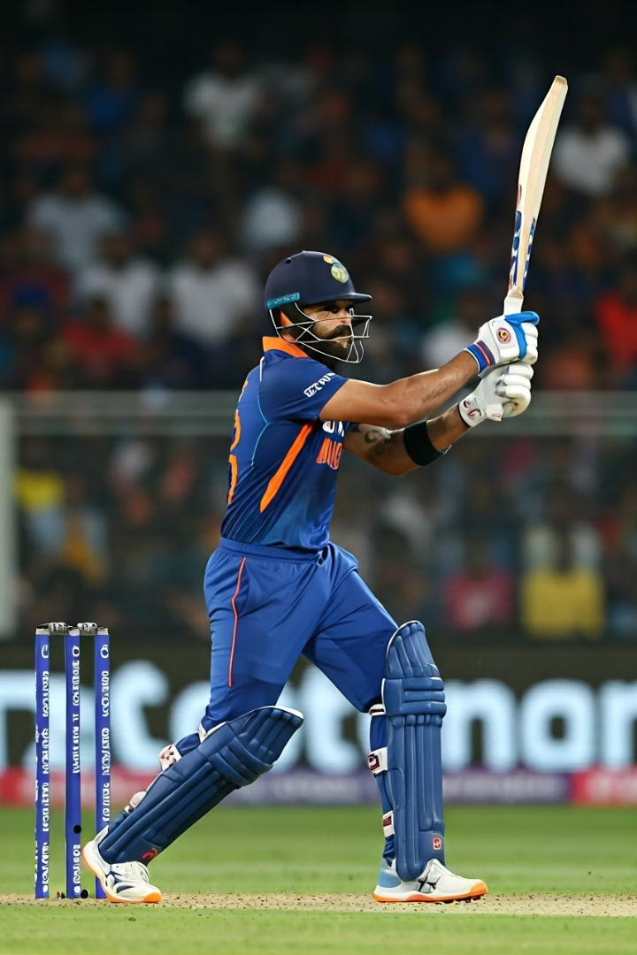
Predicting Performance: A Deep Dive into Cricket Analytics
Primary Objective
Develop Predictive Models
Analyze Virat Kohli's performance in detail.
We use advanced data mining to predict player performance.
Real-Game Scenarios
Insights apply to broader player analysis and game scenarios.

Slide 4




Sourcing the Game: Comprehensive Cricket Data
Key Data Sources
ESPN Cricinfo and the CWC Official Website were our main sources.
Additional Validation
We used other cricket databases for data validation.
Extensive Records
Collected 8,818 records with 20 attributes across seasons.

Slide 5
From Raw Data to Actionable Insights
Data Cleaning
Preprocessing
Tools Utilized
Standardized formats.
Normalized data values.
Python, Pandas, NumPy.
Handled missing values.
Encoded variables for models.
Matplotlib, Seaborn for visuals.
Removed corrupt records.

Slide 6




Building Predictive Models
Statistical Models
Machine Learning
Employed statistical approaches for predictions.
Machine learning models were used for forecasting.
1
2
Historical Validation
4
3
Regression Analysis
Models validated with historical data for robustness.
Applied regression for performance forecasting.

Slide 7

Analyzing a Master: Virat Kohli's IPL Performance
Run Rates
Averages
Analyzed run rates under various match conditions.
Evaluated averages across all matches.
1
2
3
4
Strike Rates
Strategic Contributions
Examined strike rates in different scenarios.
Insights into his batting and strategic contributions.

Slide 8
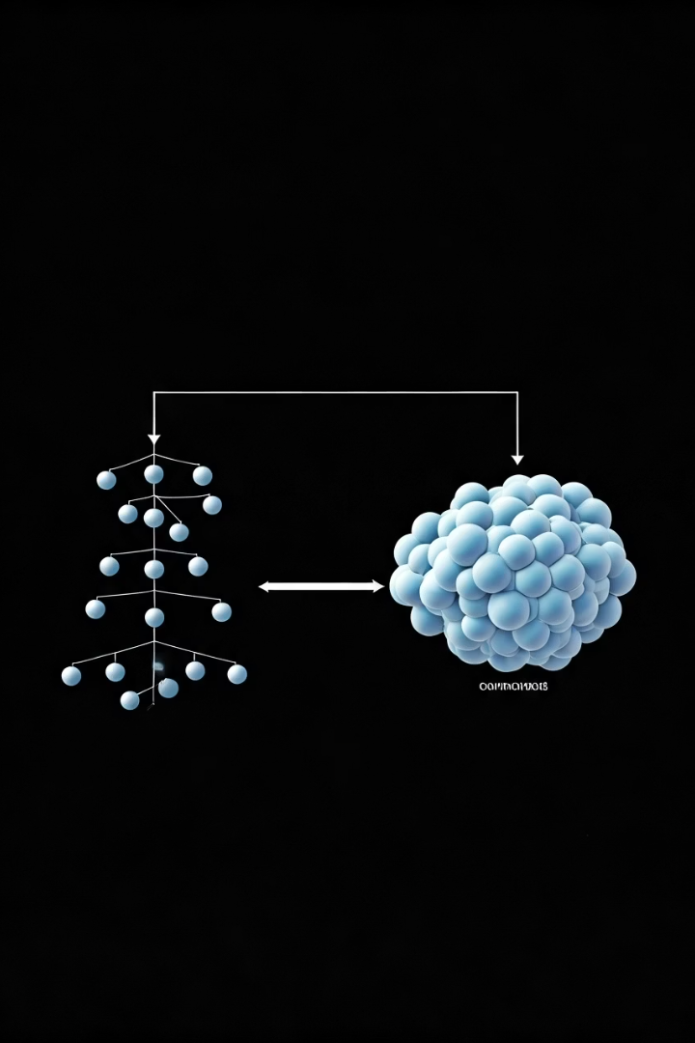



Model Validation: High Accuracy in Predictions
Decision Tree
Achieved 99.4% accuracy in performance predictions.
Random Forest
Demonstrated higher reliability with 84% accuracy.
Robust Predictions
Models included player, match, and venue data.

Slide 9




Actionable Insights for Cricket Strategy
Strategic Decisions
1
Provides data-driven decision-making capabilities.
Player Selection
2
Enhances player selection processes.
Training Focus
3
Guides specific training focus areas.
In-Match Tactics
4
Improves in-match tactical adjustments.

Slide 10

Conclusion & The Road Ahead
Crucial Analytics
Data analytics is vital for understanding player performance.
Strategic Benefits
Beneficial for coaches and sports analysts.
Expand Scope
Future work includes more players and teams.
Advanced Algorithms
Integrate real-time data and new algorithms.

